Slide 2
E
L
M
W
C
O
E

Slide 3
Class-Five
Subject:English
Lesson:1-2
Unit:9
Lesson title:A Firefighter.
Nasrin Jahan.
Assistant teacher.
53 No Batikamari G.P.S.
Muksudpur, Gopalgonj .
nasrinjahan.keya.9@gmail.com

Slide 4
Learning outcomes
Students will be able -
to say about a afirefighter in pair.
To write about any an occupation.

Slide 5
Lets see the video

Slide 6
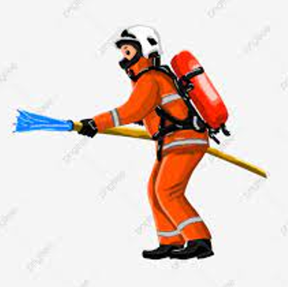
Look at the picture?

Slide 7
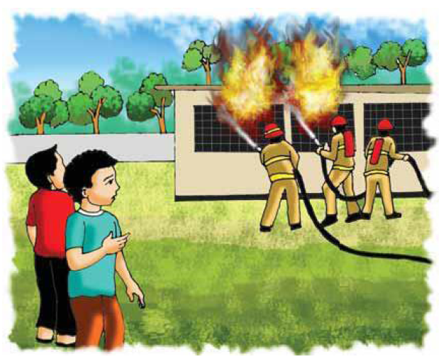
Look at the picture?

Slide 8
New words
FIRe- burn
Afraid- feeling fear
Panicked-Sudden fear
Quietly-Without making much noise
Safely- without harm
Occupations- A job
Firefighter- A person whose job it is to put out fires

Slide 10
occupations

Slide 11
Teacher will be ask every students ….
(1)Who is a firefighter?
(2) Mihir (1):Raju (3) Pallab (4) Ratan
(2)What does a firefighter do?
(a) Teaches students (b) The patient sees (c) Puts out the fire (d) worked in agriculture

Slide 12
column A | column B
(a) afraid | (i) sudden feeling of fear or nervousness
b) volunteer | (ii) without making much noise.
c) safety | (iii) state of being free from danger
d) panic | (iv) frightened
e) quietly | (v) someone who does a work willingly

Slide 13
Evaluation
Write 5 sentences about any an occupation.

Slide 14
Home work
Write 5 sentences about any an occupation.

