Slide 1
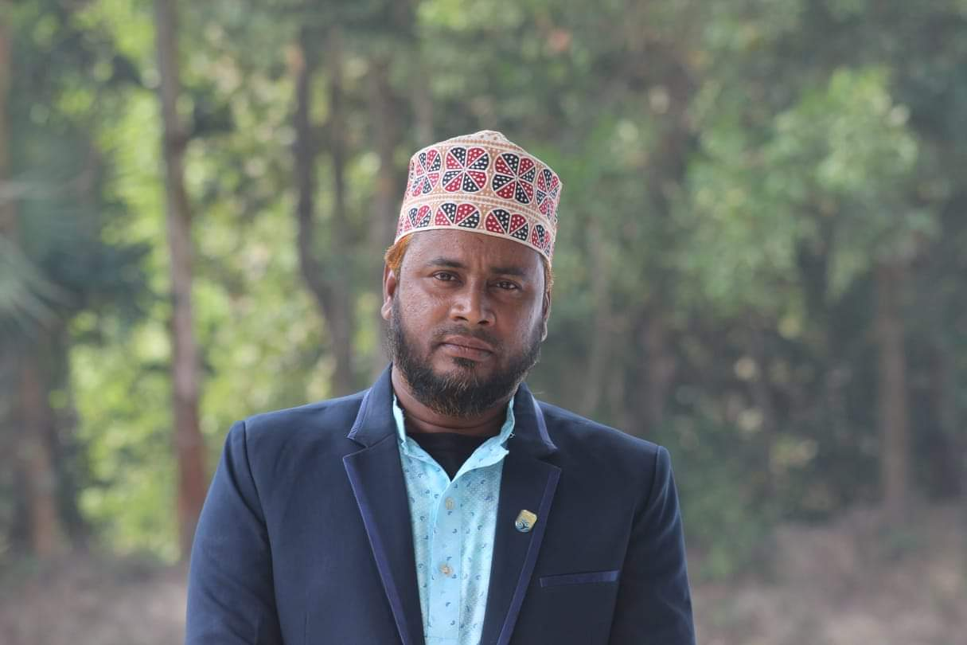
Architecture Frame Design
ABOUT MY SELP
INSTITIUTE | NORTH RANGUNIA HIGH SCHOOL
POST | ASSISTANT TREACHER
SUBJECT | ISLAM AND MORRALITY
MOBILE | 01811867584
E - MAIL | rumamun1986@gmail.com
MD RAHAT ULLAH

Slide 2
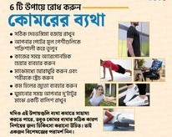
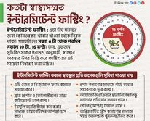
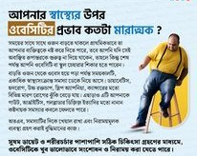
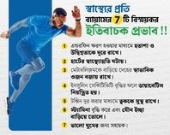
HEALTH TIPS
ভাল যদি থাকতে চান
নিয়ম মেনে চলুন

Slide 3
Working Timeline

Slide 4
HEALTH TIPS

Slide 5
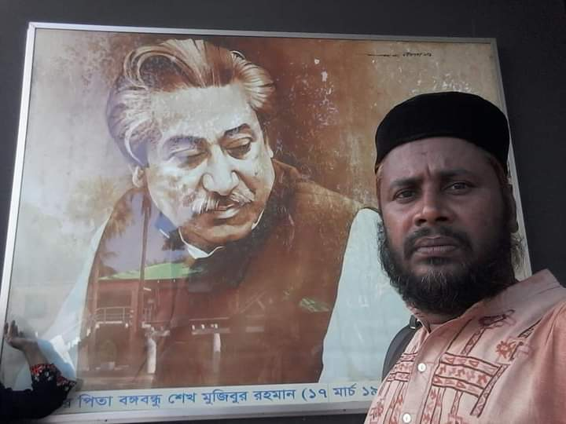
Thank you
someone@example.com

