Slide 1
Good Morning

Slide 2
Presenter
Mohammad Mahbubur Rahman
Assistant teacher
Charsobuddi Uttar Para govt: primary school
Raipura,Narsingdi..

Slide 3
Subject --English
Class --Five
Lesson --2
Unit --14

Slide 4
Learning outcomes
Students will be able to ----
Become familiar with English sounds by listening to common English words.

Slide 5
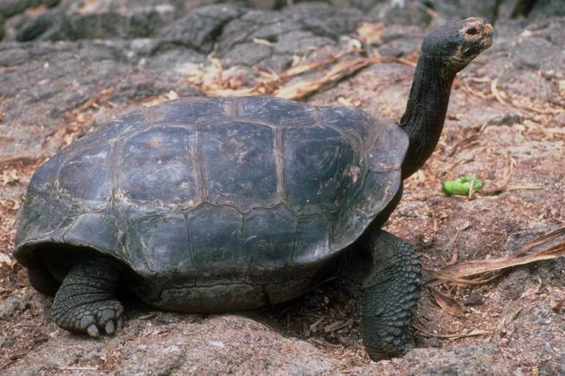
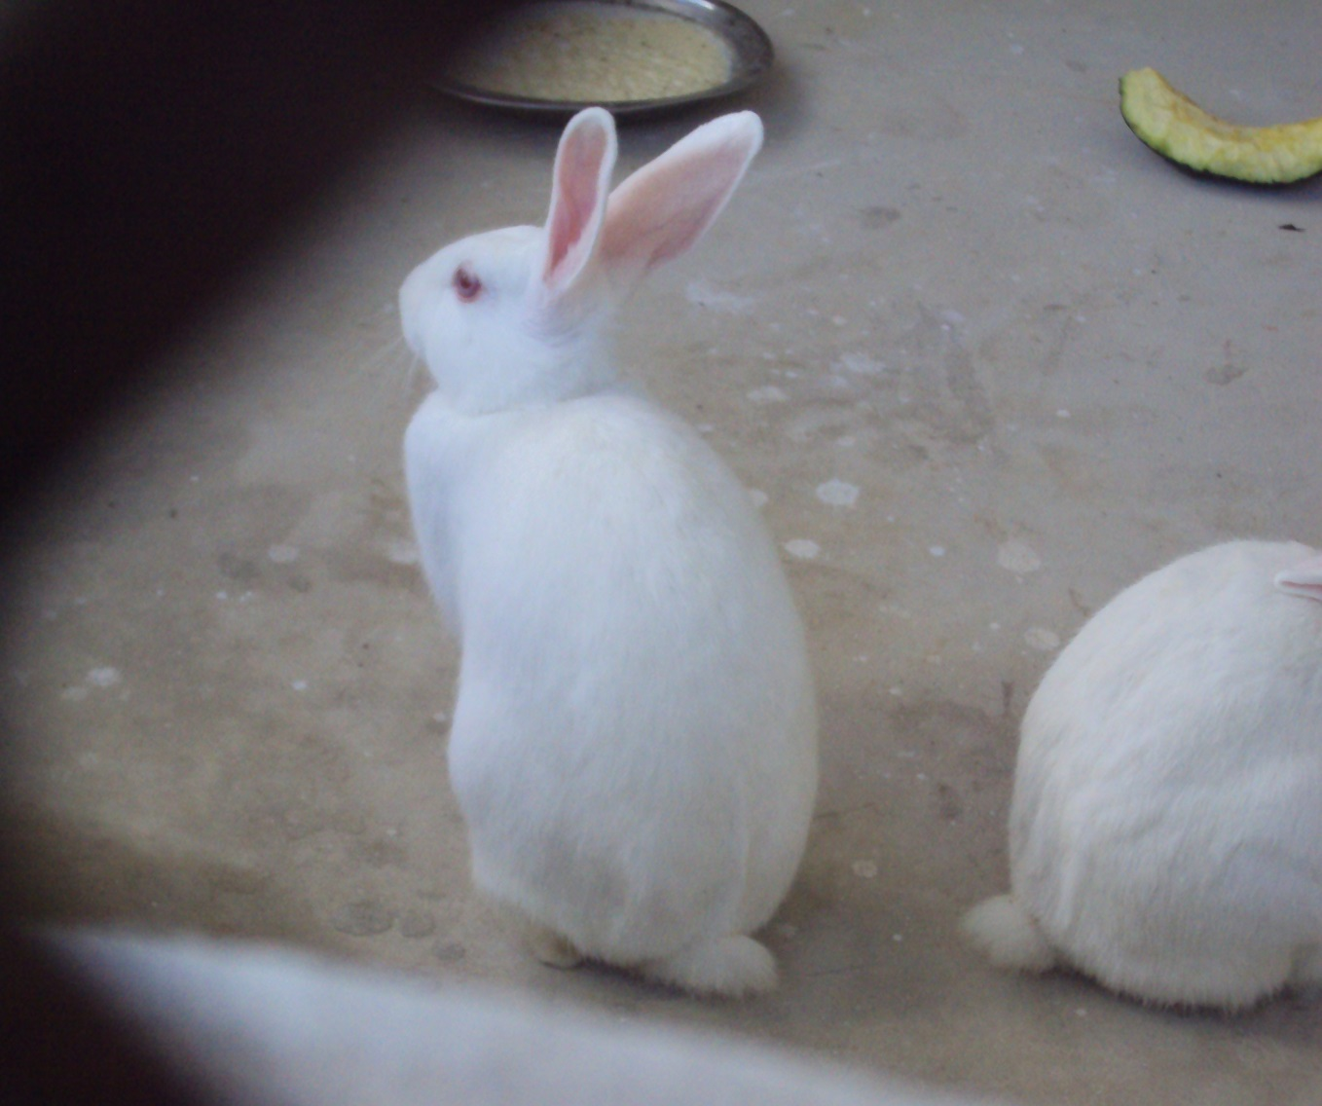

Slide 6
Lesson Introduce
The hare and the tortoise
Page No --95

Slide 7
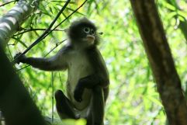
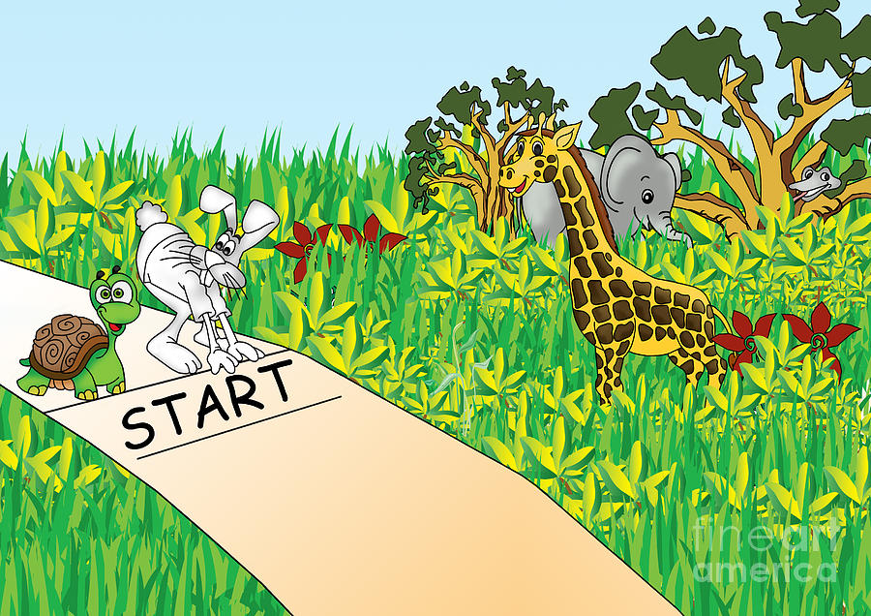

Slide 8
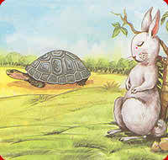
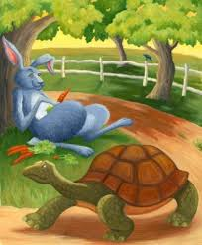

Slide 10
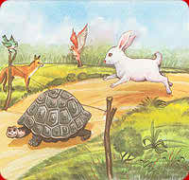

Slide 11
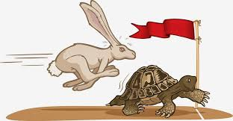

Slide 12
Take your English book and open at page --82

Slide 13
Teacher’s loud reading

Slide 14
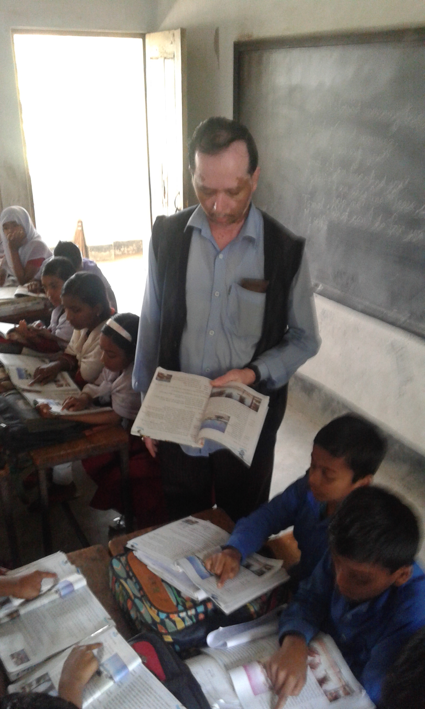

Slide 15
Read the Lesson silently and Findout difficult words

Slide 16
Group Work
Ask and answer
Group --A
* What does “slow but steady wins the race” mean?
Group ----B
Read the sentences. Complete the questions.
1. Where----------------?The hare was walking in the forest?

Slide 17
Group 2
Group 1

Slide 18
Home Task
Write five sentences about “ Slow but steady wins the race.”

Slide 19
Good Bye

