Slide 1
Well Come

Slide 2
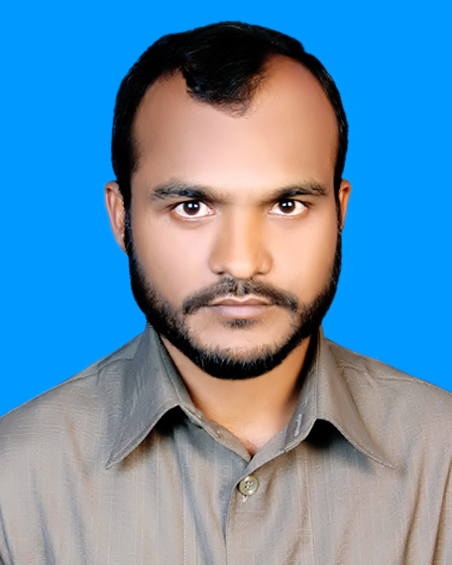
Teacher’s Introduction
Mohammad mahbubur Rahman
Assistant Teacher
Charsobuddi Uttar Para GovT.Primary School
Raipura, Narsingdi.

Slide 3
Subject --English
Class --Five
Lesson-- 1
Unit --14
Time --40 Minuites

Slide 4
Learning out comes
Students will be able to ----
Take part in conversation on appropriate topics.
2.Read silently with understanding paragraph.
3. Read silently with understanding dialouges.

Slide 6
Lesson Introduce
The hare and the tortoise

Slide 10
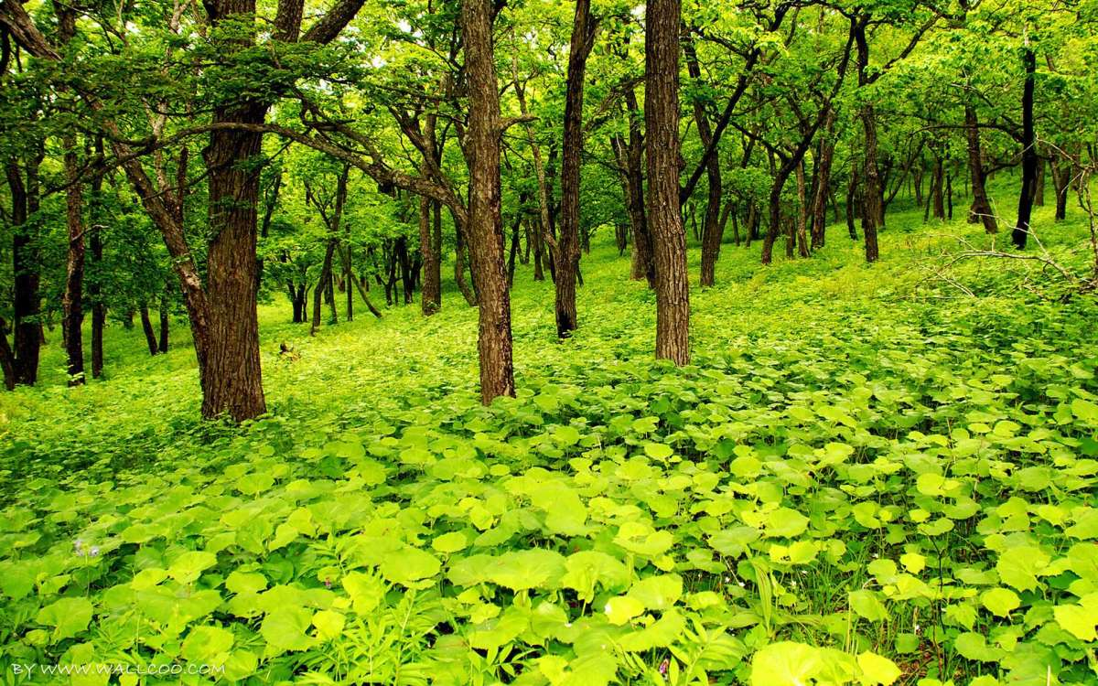

Slide 11
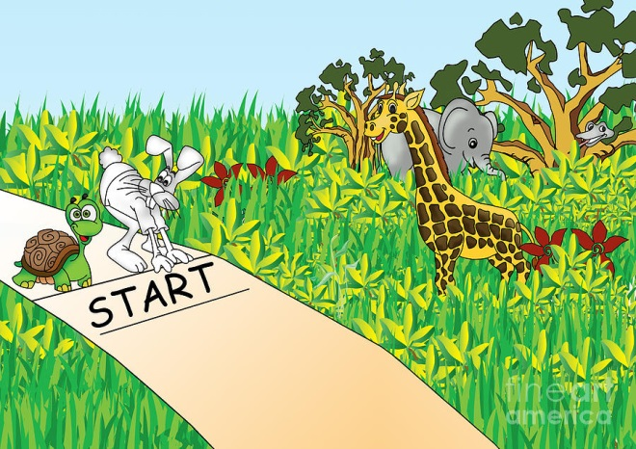

Slide 12
Take your English book and open at page --54

Slide 13
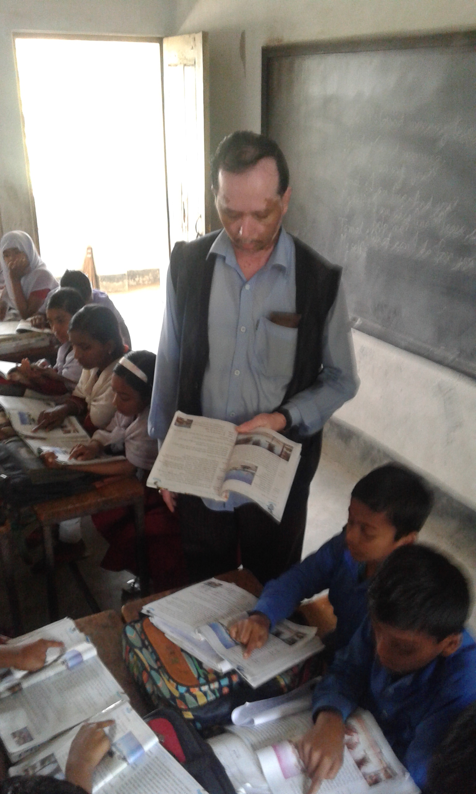
Teacher’s loud reading

Slide 14
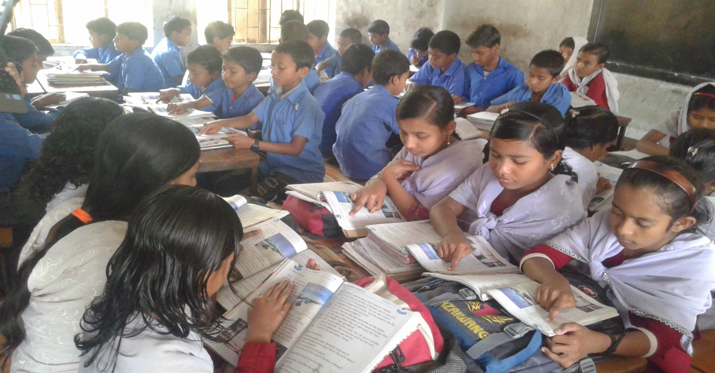
Read the Lesson silently and Findout difficult words

Slide 15
Group Work
Ask and answer
Group --B
*How far is Saint Martin’s island from Teknaf ?
Group --A
* Where was walking a hare ?

Slide 16
Use Capital letters and puntuation marks.
The tortoise felt angry and said to the hare why don’t we have a race may be i can win

Slide 17
Home Task
Write five sentences about The hare and the tortoise following lesson 1.

Slide 18
Good bye

