Slide 1
Welcome
To
Our Todays class

Slide 2
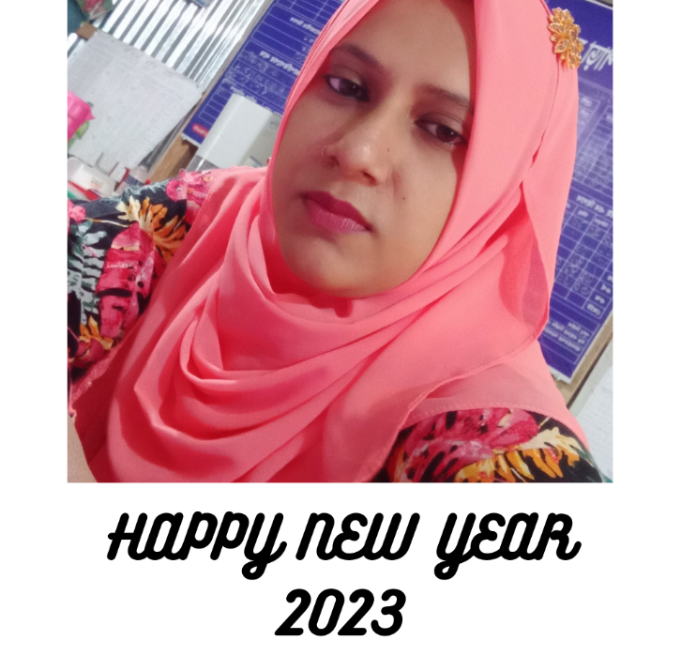
Teacher’s Identity
Nurjahan Begum
Assistant Teacher
Char Maher Master Para Govt. Primary School.
Ramgoti, Lakshmipur

Slide 3
Learning Outcomes
Students will be able to:
Listening: 3.2.1 undrestand question about
family and friend of students
Speaking:3.1.1 ask and answer Wh question
Reading: 1.7.1 read paragraphs, dialogues,
stories, letters and other text.

Slide 4
Identity
Lesson introducing-
Class- Five
Sub: English for today
Unit:- 1
Lesson: – 1

Slide 5
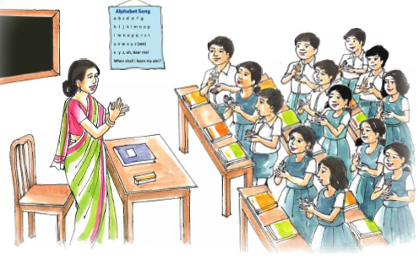
Warm up activities: Singing a song

Slide 6
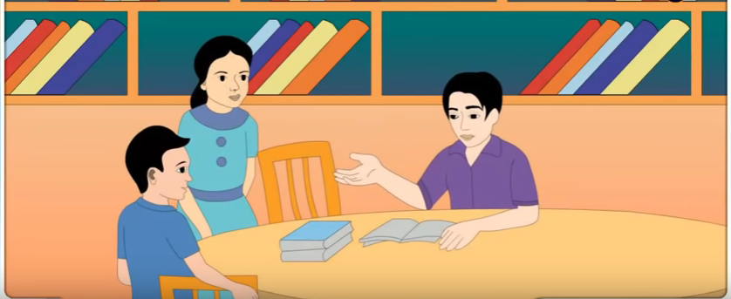
Look at the picture

Slide 7
Dear students, what can you see?
Who are there in the picture?
What’s the picture about ?
Where are the people talking?

Slide 8
Today’s lessons

Slide 9
Word meaning
Fine
Well
Meet
Gather
Friend
Companion
Sure
Certain
Chat
To have conversation

Slide 10
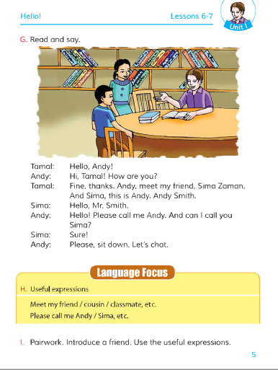
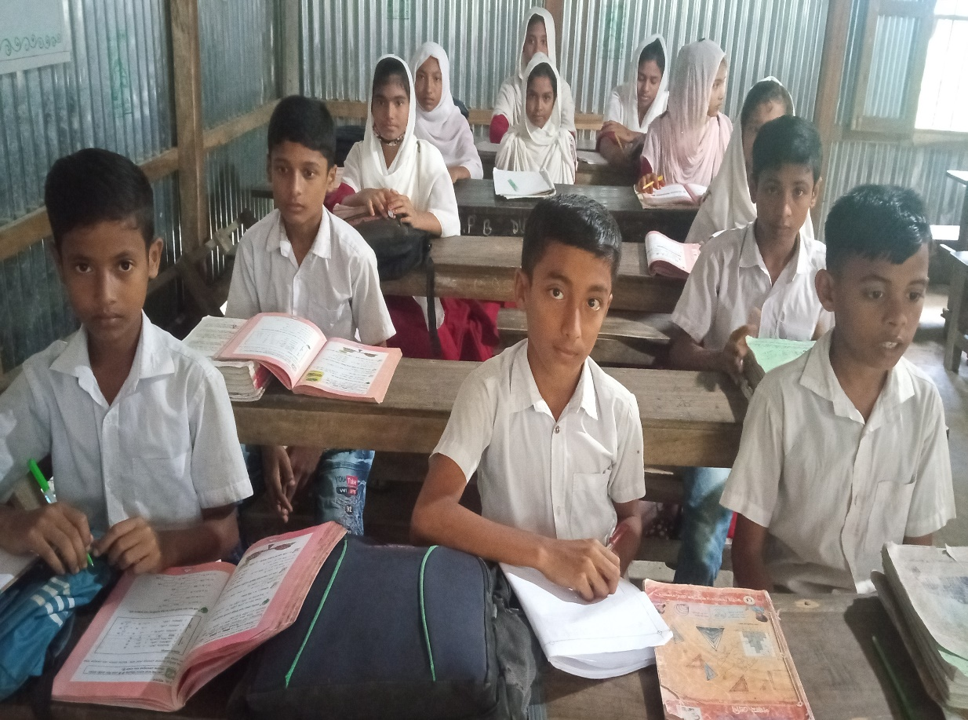
Teacher’s reading

Slide 11
Student’s reading with teacher

Slide 12
Group work.
Answer the question
Question: Who wanted to meet Andy Smith?
Answer: Sima wanted to meet Andy Smith.
Question: Who introduced Sima to Andy Smith?
Answer: Tamal introduced Sima to Andy Smith.
Question: Why does Sima want to meet Andy Smith?
Answer: Sima wants to meet Andy Smith because she wants to practise speaking English with him.

Slide 13
Pair work.
Introduce a friend.
Use the useful expressions.

Slide 14
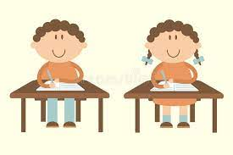
Pair work
Read the text in pair.
Make pairs and read the lines to each other.

Slide 15
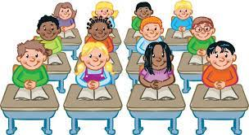
Evaluation
Read the text in one by one.

