Slide 1
Good
morning

Slide 2
Introduction
Nahidal Arjin
Assistant Teacher
Boddipur Govt. Primary School
Sadar, Satkhira.
Class : one
Subject : English
Lesson : Numbers 1-2
Unit :2 . Page :20
Date : 01/03/2023

Slide 3
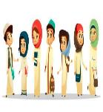
Greetings
Good morning, students.
Good morning, teacher.
How are you, my dear students?
Fine, thank you, teacher.

Slide 4
Let’s see a video song

Slide 5
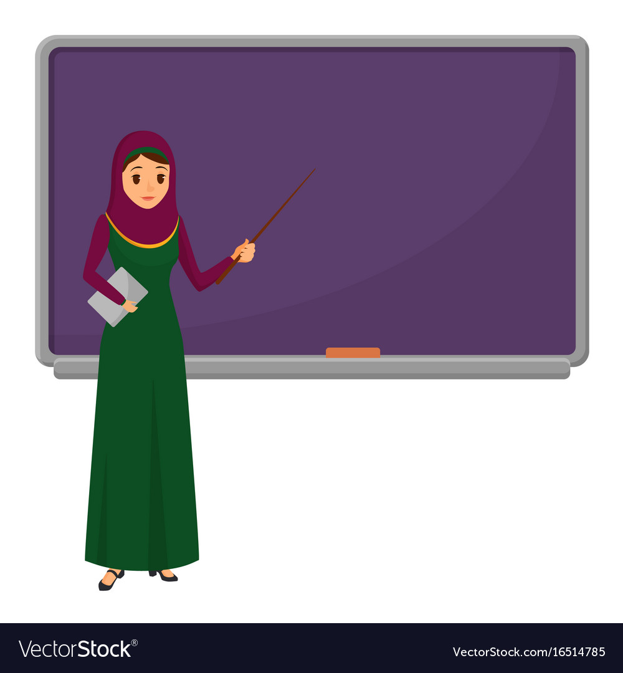
Review of the previous session:
‘What did we learn yesterday?’
cC-dD
What is the name of it?

Slide 6
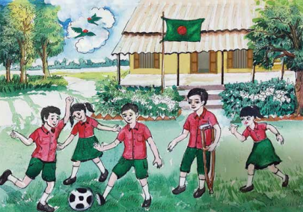
What do you see in the picture?
Yes, my dear. You are right. These are 1 ball, 2 birds, 1 flag.

Slide 7
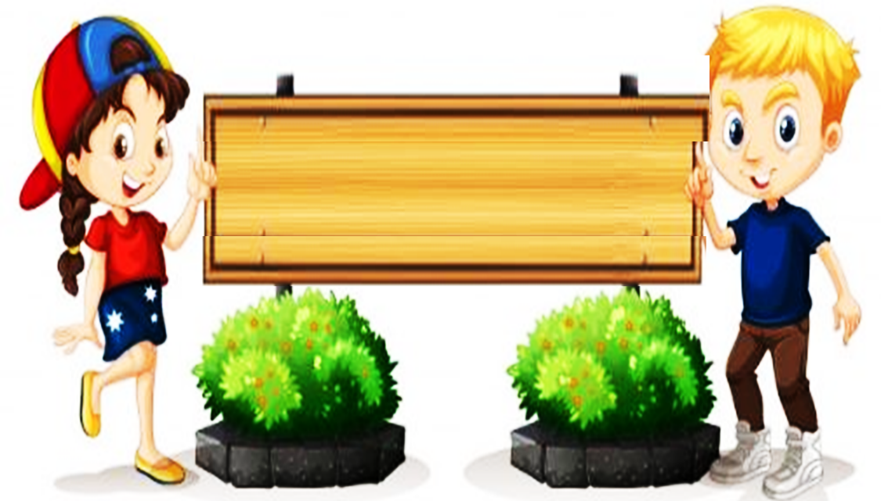
Todays lesson
is
Numbers

Slide 8
Learning outcomes
Students will able to
4.1.4
Read aloud cardinal numbers in figures properly.

Slide 9
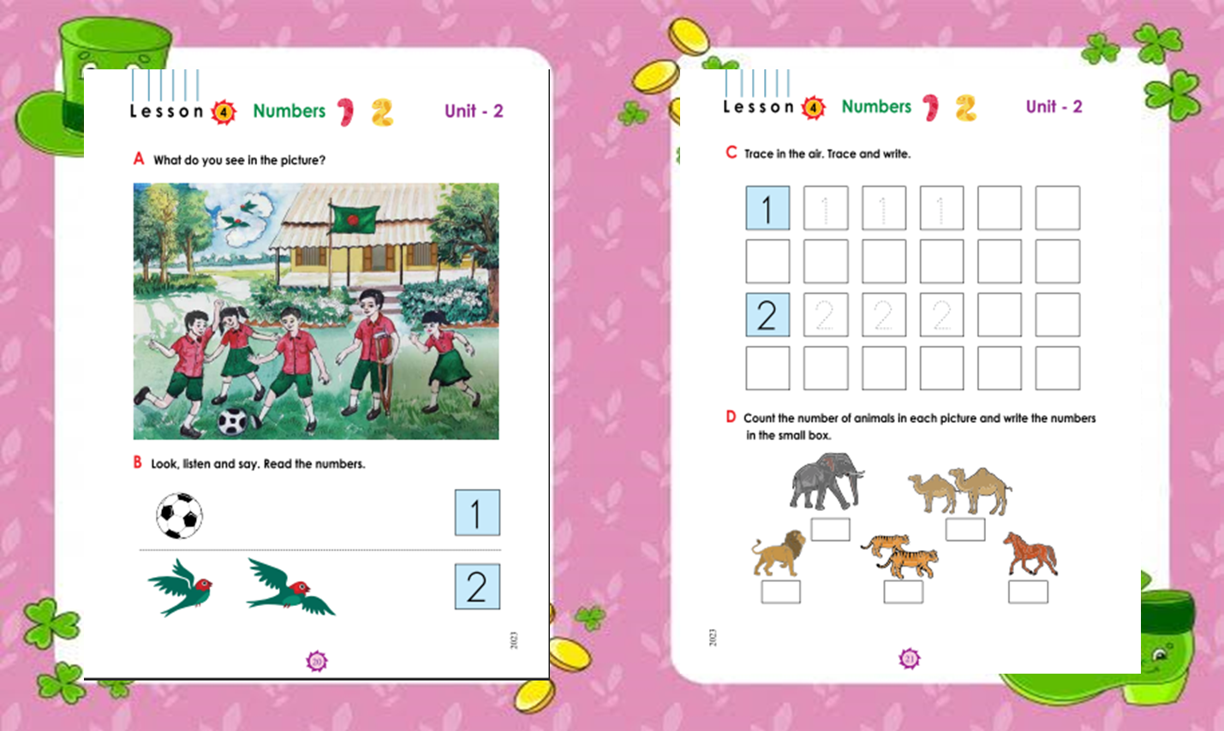
Open at page 20

Slide 10
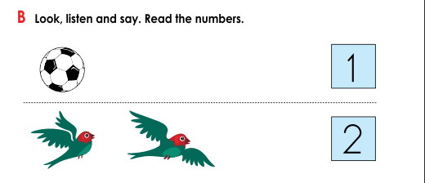
Look, listen and say. Read the numbers.

Slide 11
Look, listen and say.
1
What is this, dear students?
Yes, this is ball.
How many balls are there?

Slide 12
Look, listen and say.
2
What is this, dear students?
Yes, this is birds.
How many birds are there?

Slide 13
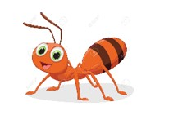
Individual work
Count and write the number.
1
2

Slide 14
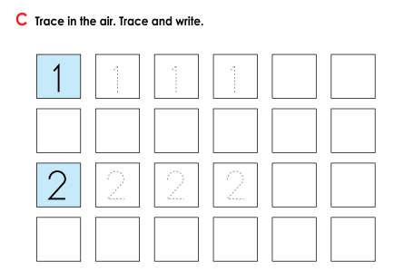
Trace in the air. Trace and write.

Slide 15
Trace in the air. Trace and write.
1
1
1
1
1
1
1
1
2
2
2
2
2
2
2
2

Slide 16
Group work
Fill in the blanks.
1
2
1
2
1

Slide 17
Evaluation
Match the picture.
1
2

Slide 18
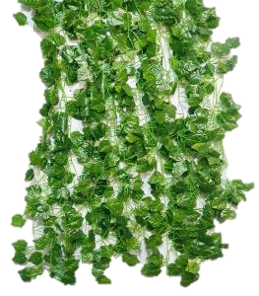
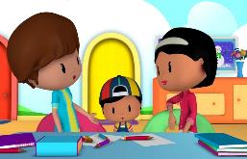
Task
Write numbers “ 1,2 ”.

Slide 19
Thank You

