Slide 1
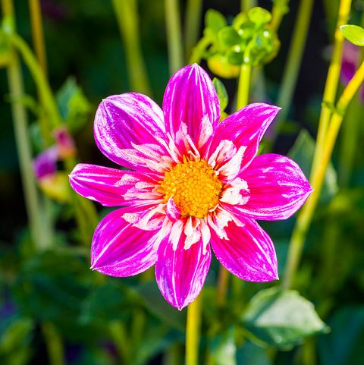
Welcome
to
You
To
Attend
the
Digital
Class

Slide 2
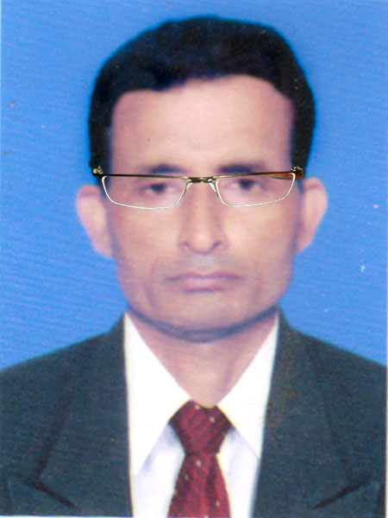
Identity
Manik Chandra Majumder
Senior Teacher
Gazirhat High School
Senbag, Noakhali.
Mobile No: 01717155169
Email: manikmajumder01@gmail.com
Class : Seven
Subject : English
Time : 6.00 hours
Date : 00/00/2023

Slide 3
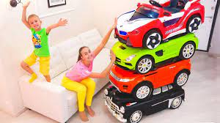
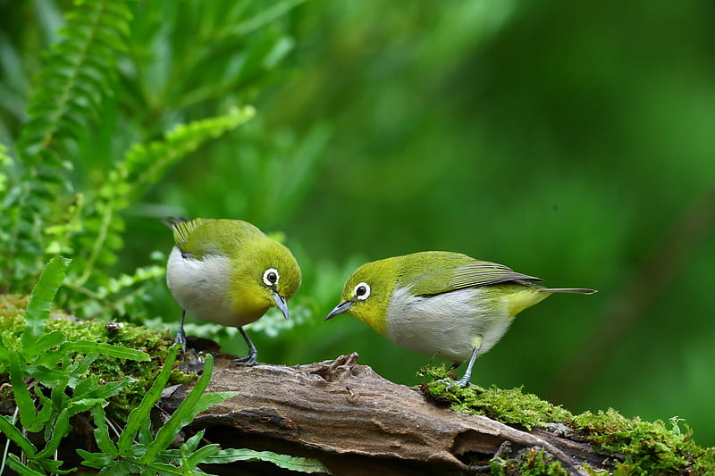
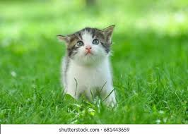
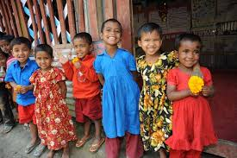
All are little things
And beings
Little toys
Little birds
Little kitten
Little children

Slide 4
So dear, Our today’s Lesson is---
Little things
Unit-2
(About 6 hours)

Slide 5
Competency 2: Ability to use appropriate vocabulary/ expression (in form of synonyms, antonyms, phrases, etc.) in accordance with the context.
At the end of the Unit, Students will be able to-
recite a poem.
tell about Rhyme.
describe about little things in our life.
Notes:
Take answer from ss

Slide 6
Experience (6.5 hours)
Firstly, SS will share their experiences of how they tried to make others happy.
Then, SS will be exposed to the poem.
After that, SS will be engaged in the discussion to find out some interesting things in the poem as well as some literary features of the poem.
Finally, they will produce texts.

Slide 7
Note
A poem is a kind of literary writing. It has some characteristics. Two of them are Stanza and Rhyming.
Stanza: A stanza is a group of lines in a poem. It consists of two or more lines arranged together as a unit. Most poems are divided into stanzas. A stanza in a poem is like a paragraph in an essay.
Rhyming: The similar sounding words at the ends of the alternate lines of a poem.

Slide 8
New vocabulary:
New Vocabularies: Mighty, Ocean, Humble, Eternity, Deeds, Eden, Heaven, Above, Alternate.
Key Word: Mighty ( Adj)
Synonym : Massive/ Huge/ বিশাল
.Antonym: Little/ Tiny/Small ( ছোট)
Example Sentence:The mighty ocean can be used to produce electricity.
Example Sentence:Elephant is a mighty animal.

Slide 9
New vocabulary:
Key Word: Ocean ( Noun) সমুদ্র
Synonym: Sea/ blue/ brine (মহাসমুদ্র/সমুদ্র)
Antonym: Shore/ Beach (সমুদ্রের তীর)
Example Sentence: Oceans are a source of food for mankind..
Your Sentence: I like to see ocean .

Slide 10
New vocabulary:
Key word: Humble (Adj)
Synonym: Modest/ Gentle (ভদ্র/ বিনয়ী)
Antonym: Rude (অভদ্র) Proud (অহংকারী)
Example Sentence:
Everybody praises him for his humble behaviour.
Your Sentence: His humble behaviour pleased me.

Slide 11
New vocabulary:
Key Word: Eternity (Noun)
Synonym: Infinity/Everlasting (চিরন্তন)
Antonym: Mortal / Temporay.
Example Sentence:The pious would spend eternity in heaven.
Your Sentence: We believe pious spend eternity in heaven.

Slide 12
New vocabulary:
Key Word: Deeds (Noun)
Synonym: Actions/ Activities (কাজ)
Antonym: Rest/ Leisure (বিরতি)
Example Sentence:
Man should be judged by his deeds.
Your Sentence: Man lives in deeds not age.

Slide 13
New vocabulary:
Key Word: Eden (Noun)
Synonym: Heaven/ Paradise (স্বর্গ/ বেহেশ্ত)
Antonym: Hell (দোজগ)
Example Sentence: Adam and Eve first lived in the Eden.
Your Sentence: My garden is an Eden to me.

Slide 14
New vocabulary:
Key word: Above (Adv/Prepositions/ Adj.
Synonym: Over/Beyond (উপরে )
Antonym: Down / Under (নিচে)
Example Sentence: Our plane was flying above the clouds.
Your Sentence. The water came above our knees

Slide 15
Key Word: Alternate (Adj. /verb)
Synonym: Different/ Another
Antonym: Similar
Example Sentence: We chose alternate (adj) route to avoid traffic jam.
Example Sentence: The poem alternates (v) fear and hope.
Your Sentence : Due to an emergency, the plane landed at an alternate airport.

Slide 16
New vocabulary:
Key Word: Heaven (Noun)
Synonym: Paradise/ Dream place (স্বর্গ)
Antonym: Hell (দোজগ)
Example Sentence:Everybody prays to go to heaven after death.
Your Sentence : We pray to god for heaven.

Slide 17
2.1 Ask and answer the following questions in pairs.
a) How do you help your parents at home? Does that make you or them happy?
b) What do you usually do to make your brother/sister/friend happy when they are sad?
c) Do you feel happy when they become happy?
d) Have you ever been on a road trip to the hills?
e) Have you ever been to Cox’s Bazar or any other sea beaches? How did you feel then?

Slide 18
a) How do you help your parents at home? Does that make you or them happy?
Answer:
I help my parents in the following ways: (Any 2/3 points)
I myself clean our beds after getting up from bed.
I help my father in agricultural activities.
I help my mother in the kitchen.
I look after my little sister and my grand mother.
I feed our pet and cattle.
I look after the plants in the garden and water them from time to time.
Really, my parents are very happy for my activities. And I also happy doing such activities.
Notes:
Take answer from ss

Slide 19
b) What do you usually do to make your brother/sister/friend happy when they are sad?
Answer: When my brother/sister/friend is/are sad, I try to overcome the sad moment by playing games, telling jokes, watching a movie or TV show etc. with him/her/them.
c) Do you feel happy when they become happy?
Answer: Yes, feel happy when they become happy.
Notes:
Take answer from ss

Slide 20
d) Have you ever been on a road trip to the hills?
Answer: Yes, I have been on a road trip to the hills. It is very interesting and thrilling.
e) Have you ever been to Cox’s Bazar or any other sea beaches? How did you feel then?
Answer: Yes, I have been to Cox's Bazar. It's really a great experience for me. We visited there last year. We all know that it is one of the longest and most beautiful sea beach in the world. I take bath in there. We play football with some other persons. We stay 3 days on a hotel which was quite near from Cox's Bazar. When I fell it, I become excited.
Notes:
Take answer from ss

Slide 21
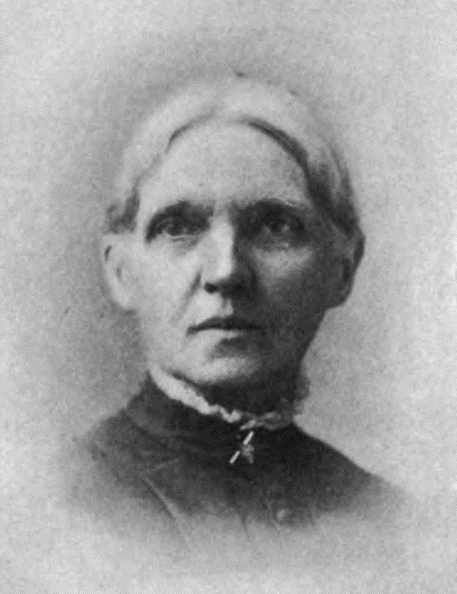
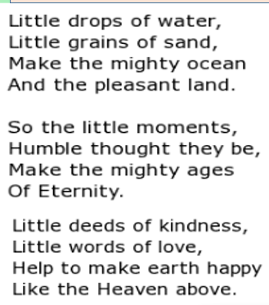
Look at the image.
Now read the Rhyme of poem.
Julia Abigail Fletcher Carney

Slide 22
2.2 Now, listen to the poem “Little Things” carefully and fill up the missing words in the poem.

Slide 23
2.2 Now, fill up the missing words in the poem.
Little drops of water,
Little grains of -------,
Make pleasant---------
Thus the ……he mighty ocean
And the minutes,
Humble though they be,
…… the mighty ages
Of eternity.
Little deeds of-------------
Little words of ………….,
Make our ……… an Eden,
Like the heaven above
sand
kindness
love
land,
earth
little
Make
Notes:
Take answer from ss

Slide 24
2.3: Let’s play the Listening Game, “Lend your ears”
Pronounce these words with your partner then make sentence .
Drops
Eden
grains
heaven
Sand
above
Land
Love
mighty
make
eternity
like
little
deeds
humble
words

Slide 25
2.4 Read the poem in pairs to find out the correct words/phrases from the box and write next to the sentences. You can choose more than one answer.
Little drops of water
Words of love
Grains of sand
The mighty ages
Deeds of kindness
What makes a land pleasant?...........................................................................
b) What makes the earth an Eden?.......................................................................
c) How much water makes a mighty ocean? ........................................................
d) What makes the earth heaven?........................................................................
Notes:
SS will do and Teacher will be monitoring

Slide 26
2.4: Read the poem in pairs to find out the correct words/phrases from the box and write next to the sentences. You can choose more than one answer.
Little drops of water
Words of love
Grains of sand
The mighty ages
Deeds of kindness
Grains of sand
What makes a land pleasant?...........................................................................
b) What makes the earth an Eden?.......................................................................
c) How much water makes a mighty ocean? ........................................................
d) What makes the earth heaven?........................................................................
Words of love
Little drops of water
Deeds of kindness

Slide 27
2.5: Read the note and answer the following questions in pairs.
Note
A poem is a kind of literary writing. It has some characteristics. Two of them are Stanza and Rhyming.
Stanza: A stanza is a group of lines in a poem. It consists of two or more lines arranged together as a unit. Most poems are divided into stanzas. A stanza in a poem is like a paragraph in an essay.
Rhyming: The similar sounding words at the ends of the alternate lines of a poem.

Slide 28
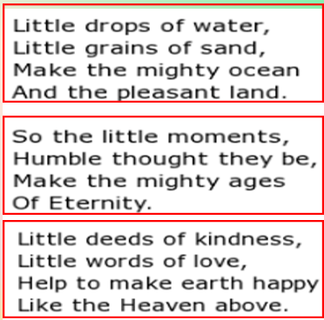
Questions:
a) How many stanzas are there in the poem titled ‘Little things’?
Answer: There are three stanzas in the poem.

Slide 29
Questions:
b) Match the rhyming words.
Cat | Stay
Day | Land
Coat | Hat
Pick | Boat
Sand | How
Now | Kick
Cat | Hat | Bat, Fat, Mat, Rat,
Day | Stay | Bay, Lay, May, Pay
Coat | Boat | Goat, Moat
Pick | Kick | Wick, Sick, Pick
Sand | Land | Band, Hand,
Now | How | Low, Sow, Row, Wow

Slide 30
Questions:
b) Match the rhyming words.
Cat | Hat | Bat, Fat, Mat, Rat,
Day | Stay | Bay, Lay, May, Pay
Coat | Boat | Goat, Moat
Pick | Kick | Wick, Sick, Pick
Sand | Land | Band, Hand,
Now | How | Low, Sow, Row, Wow
Cat | Stay
Day | Land
Coat | Hat
Pick | Boat
Sand | How
Now | Kick

Slide 31
c) Can you identify the rhyming words in the following lines?
Answer:
i) Little grains of sand
And the pleasant land
ii) Humble though they be
of eternity
iii) Little words of love
Like the heaven above

Slide 32
2.6: Make a list of the “little things” you usually do and share it with the class.
For example:
I wash my hands before I eat. I keep my room clean. I wash my clothes in off day ----------------------------
Some clues---
I arrange my table.
I arrange my school bag.
I plan weekly meals.
I do grocery shopping.
I water in my plants.
I throw away the garbage in bin.
I sweep floor.
I feed pets and cattle.
I water in kitchen garden.
I take out the trash.
I make ready my bed.
I clean the bathrooms.

Slide 33
2.7 :Group work
Design a poster on ‘The little steps to keep the classroom neat and clean’ and present it to the class.
Answer: We stay at least 6 hours at School. So it is very essential to keep the classroom clean . It’s a very simple task. First, We all students will get together. Students will express their idea about cleanliness. We will make some groups as Group A,B,C,D,E, etc .
Such as ‘Group-A’ will brush, ‘Group-B’ will sweep the room, ‘Group- C’ will move the chair, table, and benches for easy cleaning, ‘Group-D’ will sweep spider nets around the roofs and corners of the classroom And ‘Group-E’ will rearrange chair, table, and benches as before. After that, We will be ready to bust out all the dust from the chair, table, and benches. Finally, we will wash our hands.

Slide 34
Students Activities: Designing poster paper

Slide 35
Notes:
Instructions: (i) ' Engage 2 students to read and act out the conversation. One of the SS will be Faria and the other will be Raihan. The rest of the SS will listen.

Slide 36
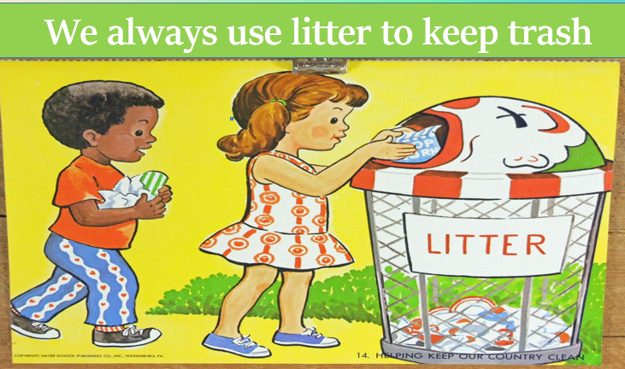
Notes:
ii) Ask ss to find unknown words and elicit the meaning. The teacher will help if necessary.

Slide 38
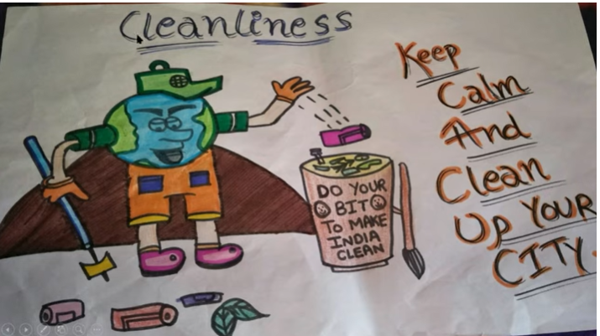

Slide 40
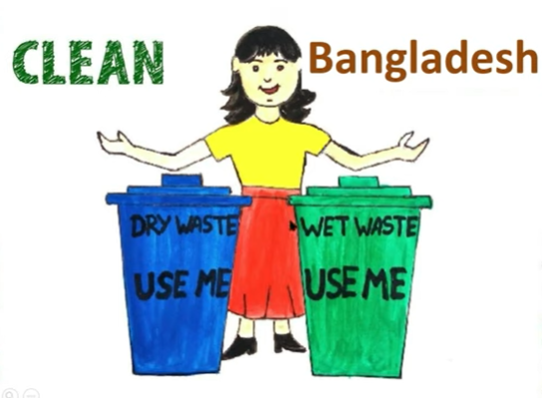

Slide 41
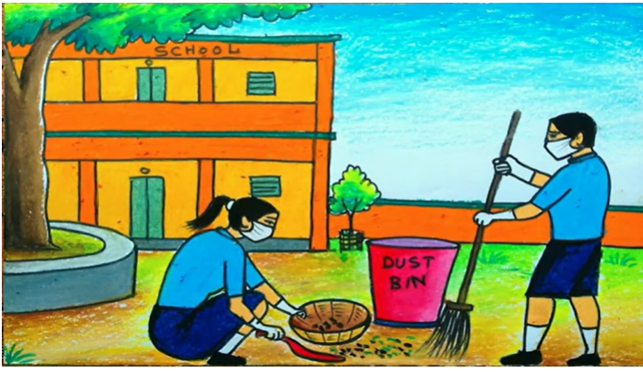
Notes:
Thus ss will make Similarities and Dissimilarities according to TG

Slide 42
Good
Bye
For
Today,
Thank you

